Slide 1




HOLLAND'S SIX PERSONALITY TYPES
(RIASEC MODEL)
Presentation by Nouran El-Bahaie, Alaa El-Hariry, Raghda El-Said, Nour El-Shafey

Slide 2

INTRODUCTION
John L. Holland, Ph.D., professor emeritus at Johns Hopkins University, is a psychologist who devoted his professional life to researching issues related to career choice and satisfaction. He developed a well-known theory and designed several assessments and supporting materials to assist people in making effective career choices.
Holland proposed personality personality job fit theory which identifies six personality types and proposes that the fit between personality type and occupational environment determines satisfaction .

Slide 3

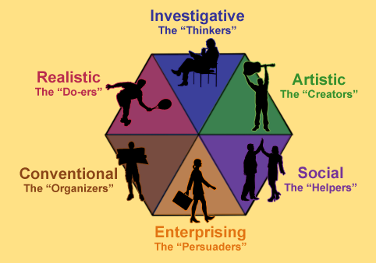
THE SIX TYPES
The six personality types are:
Realistic (R)
Investigative (I)
Artistic (A)
Social (S)
Enterprising (E)
Conventional (C)
This model is known as RIASEC.

Slide 4

ARTISTIC
Character:
Imaginative
Idealistic
Disorderly
Prefer:
Unsystematic activities
Environments that allow expression
Flexibility instead of strict rules

Slide 5
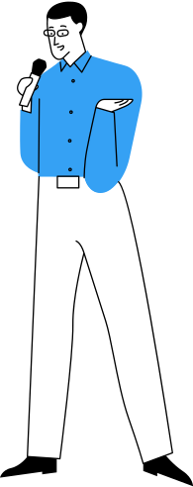
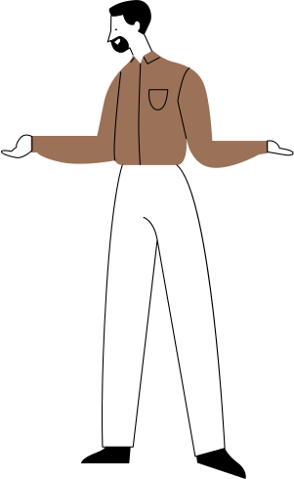
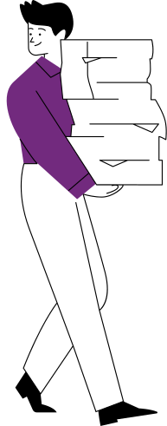
REALISTIC
Character:
Practical
Down-to-earth
Action-oriented
Prefer:
Hands-on work
Working with tools, machines, or equipment
Practical tasks

Slide 6


CONVENTIONAL
Character:
Organized
Detail-oriented
Dependable
Prefer:
Accuracy and order in daily work
Routine tasks with predictable outcomes

Slide 7

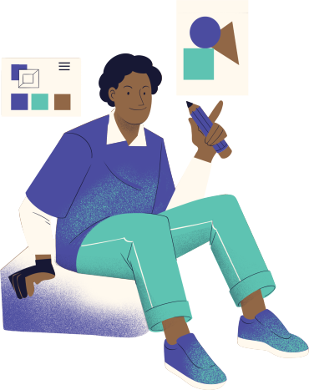

INVESTIGATIVE
Likes analyzing data and solving complex problems.
Focuses on understanding why things happen.
Prefers facts and evidence over assumptions.

Slide 8
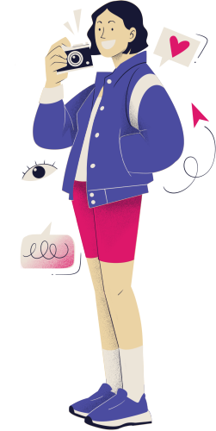


SOCIAL
Enjoys helping and supporting other
Works well in teams and values collaboration.s
Focuses on people and positive impact..

Slide 9

ENTERPRISING
Characteristics :
Leadership and persuasion skills
Confident and motivates others
Decision making
Career:
Business / Sales manager
Marketing
Project Manager
Politician

Slide 10



CONCLUSION
Holland’s theory shows that people have different personality types , and understanding our personality helps us make better career choice and achieve higher job satisfaction.

Slide 11


THANK YOU
We hope this presentation provides a brief explanation into Holland's six personality types.

